Slide 1
Team Automatas 4.0 Capstone Project Reshape B2B Offering Competency with digital Technologies July 2021
siemens.com
Unrestricted © Siemens AG 2021

Slide 2






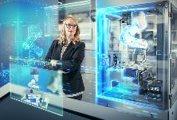






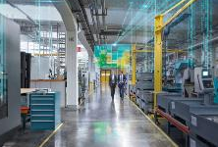



















Capstone Company: Siemens Digital Industries
Software
Area 125,000 customers
Factory Automation
OEM 22,000 customers
Motion Control
Verticals 15,000 customers
Digital Enterprise Offerings
Partners 7,500 partners
Process Automation
Software 90,000 customers
Customer Services
Online sales
Exemplary selection

Slide 3
Capstone Company: Project Structure (with Key Deliverables)
Reshape B2B Offering Competency with digital Technologies
Mr. Shaun Jia
Ms. Stephanie Zhang
Mr. Santiago Jove
Ms. Chen Bin Bin
Mr. Benny Chew
Mr. Shane Wu
Sub Module 1
AI / Big Data Market + Portfolio Fit
Sub Module 2
Value Sales Training
Sub Module 3
People Competency & Development
Sub Module 4
AI / Big Data - Proof of Concepts
External View:
Overview of current AI / Big Data B2B Offerings in the Market
Overview of selected Customer’s Pain Points where AI/Big Data could be the solution
Internal View:
Overview of Siemens current Offerings for AI / Big Data with List of Reference Projects
Develop 2 days B2B Digitalization Training Course for internal Sales Workforce including:
Digitalization Basics
2 real Siemens Case Studies
Showroom Tour
2-3 Quiz
Training Satisfactory Survey
Draft Siemens AI Development Program (1. Students, 2. Professional)
Overview of AI / Big Data Competences for B2B
What skills demanded in market?
What skills demanded by Siemens?
Identify suitable AI / Big Data Courses for Re-education of high potential staff
Overview Siemens IT Enginering Competence (Current – Future)
Predictive Maintenance Big Data:
VW (Plant: Shanghai)
Daimler (Plant: Beijing)
Jaguar Land Rover (Plant: Changshu)
Henkel (Optional)
AI Machine-2-Machine:
Flex (Optional)

